Slide 1
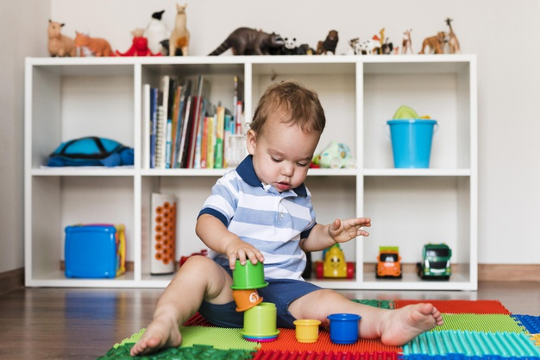
Importance of toys
Kids are bored sitting at home in the lockdown

They need something which can keep them busy.
Toys are the best solution to the problem as per the troublesome scenario

Slide 2
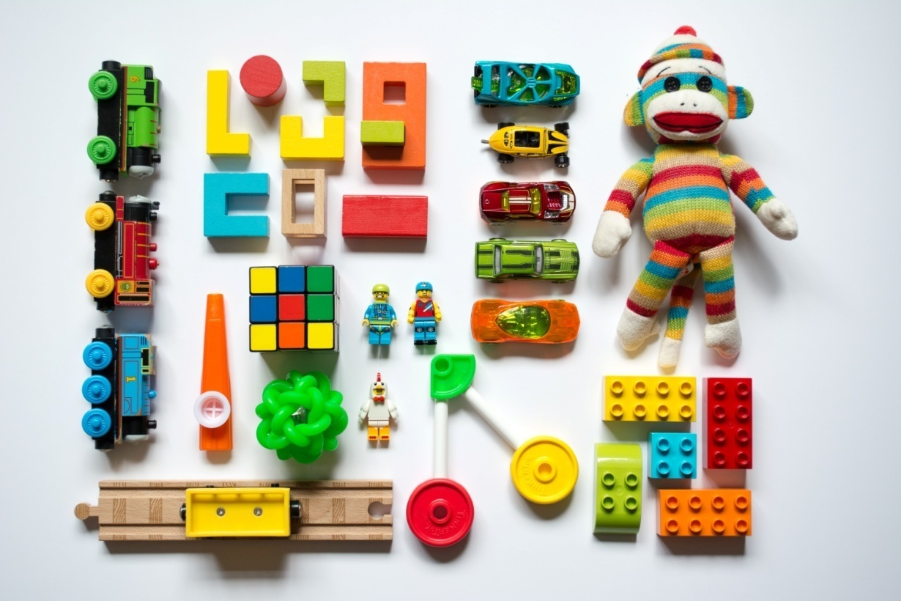
Why to buy toys for kids online?
Availability of varieties of toys
One can choose from numerous brands and colors
Parents can buy toys for kids online according to the kid’s age
Safe delivery of toys at home

Slide 3
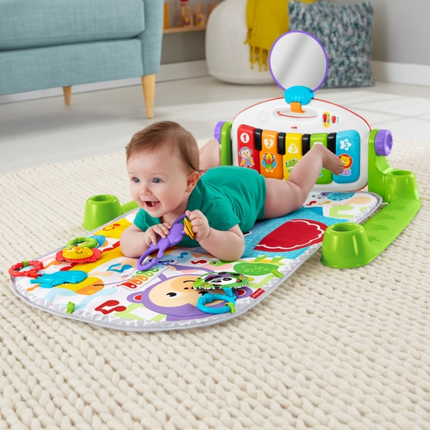
Kick and play game
Child can lie down comfortably and kick the cushioned piano keys
A baby feels happy on hearing the sweet sound played by kicking
Perfect toy for the kids below three months of age

Slide 4
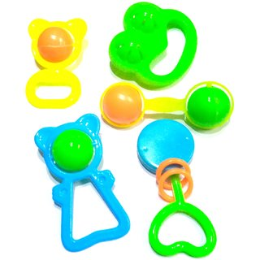
Rattles – For 0-3 months baby
Colors of the rattles attract toddlers of this age
Sounds catch attention of the kids
Analyzes hearing and observation capability

Slide 5
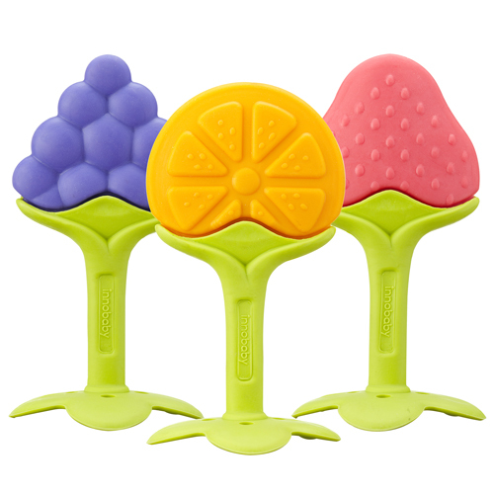
Teether for kids - 3-6 months
Teething troubles are not easy to handle for your little sweetheart.
Your kid can feel relaxed while chewing these soft teethers.
They are harmless and made up of soft material that relaxes and comforts your baby’s itching gums.

Slide 6
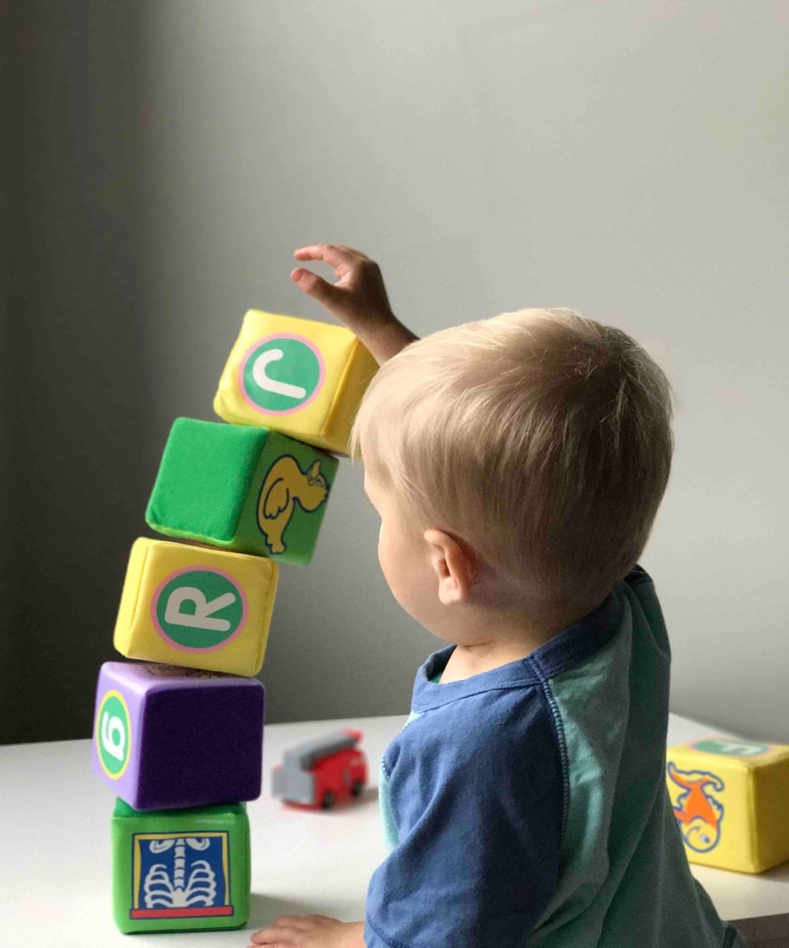
Building blocks for 6-12 months
Your grown up kid needs now needs more constructive and mind storming activities now.
Block game helps in enhancing your child’s mental, logical and analytical ability
It creates balance in the child’s arms and fingers
A child becomes more organized

Slide 7
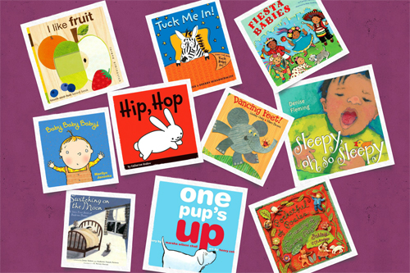
Story books for 12-18 months
Reading bedtime stories for your baby is the best practice.
The ability to imagine and fantasize is the result of reading bedtime stories to kids.
The bonding of catchy pictures and the stories make your child more creative.
Keep children away from mobile screens.

Slide 8
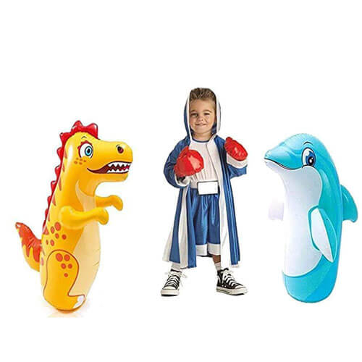
Hit Me! For 18- 24 Months
Hit Me is a boxing partner, a friend, a companion or a happy buddy your child can play with.
It is a patient friend for your kid, who can take as many punches your child wants.
A good source of entertainment, your child can pour his energy on.
It is a lockdown friend for your naughty one.

Slide 9
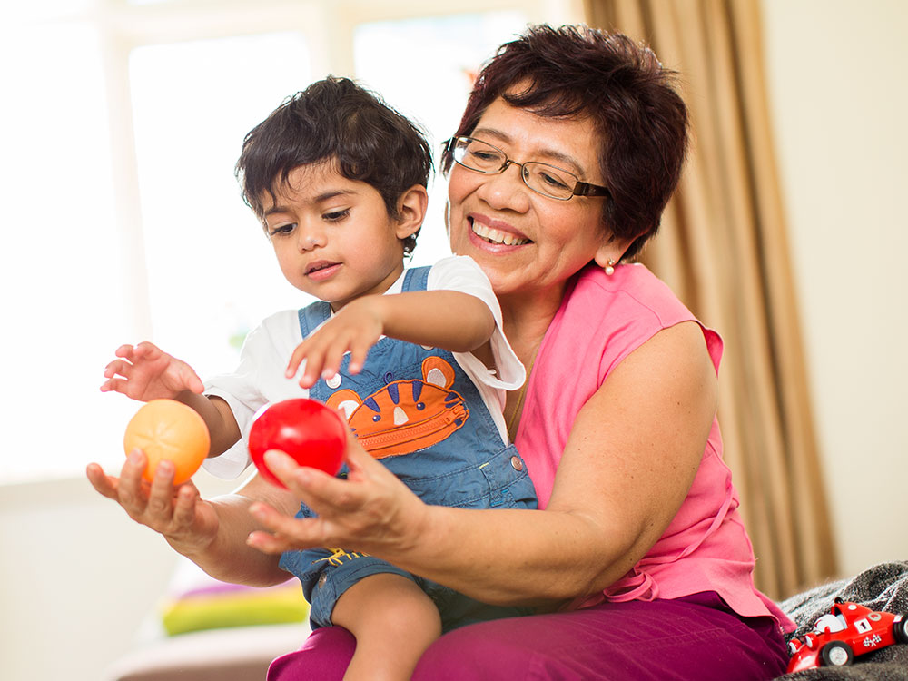
A working mother playing with a baby
Have a lovely moments and preserve memories for life with your kid.
Spend some time with your kid playing with toys and reading books to him.
Be his/her companion and act silly while playing with the little one.

Slide 10
Refer to
http://goodforkids.in/significance-of-toys-for-kids-online/

